Slide 1


Case Presentation
Joseph Rabban MD MPH
Professor
Pathology Department
University of California San Francisco
San Francisco, CA, USA

Slide 2
Conflict of Interest Statement
None

Slide 3
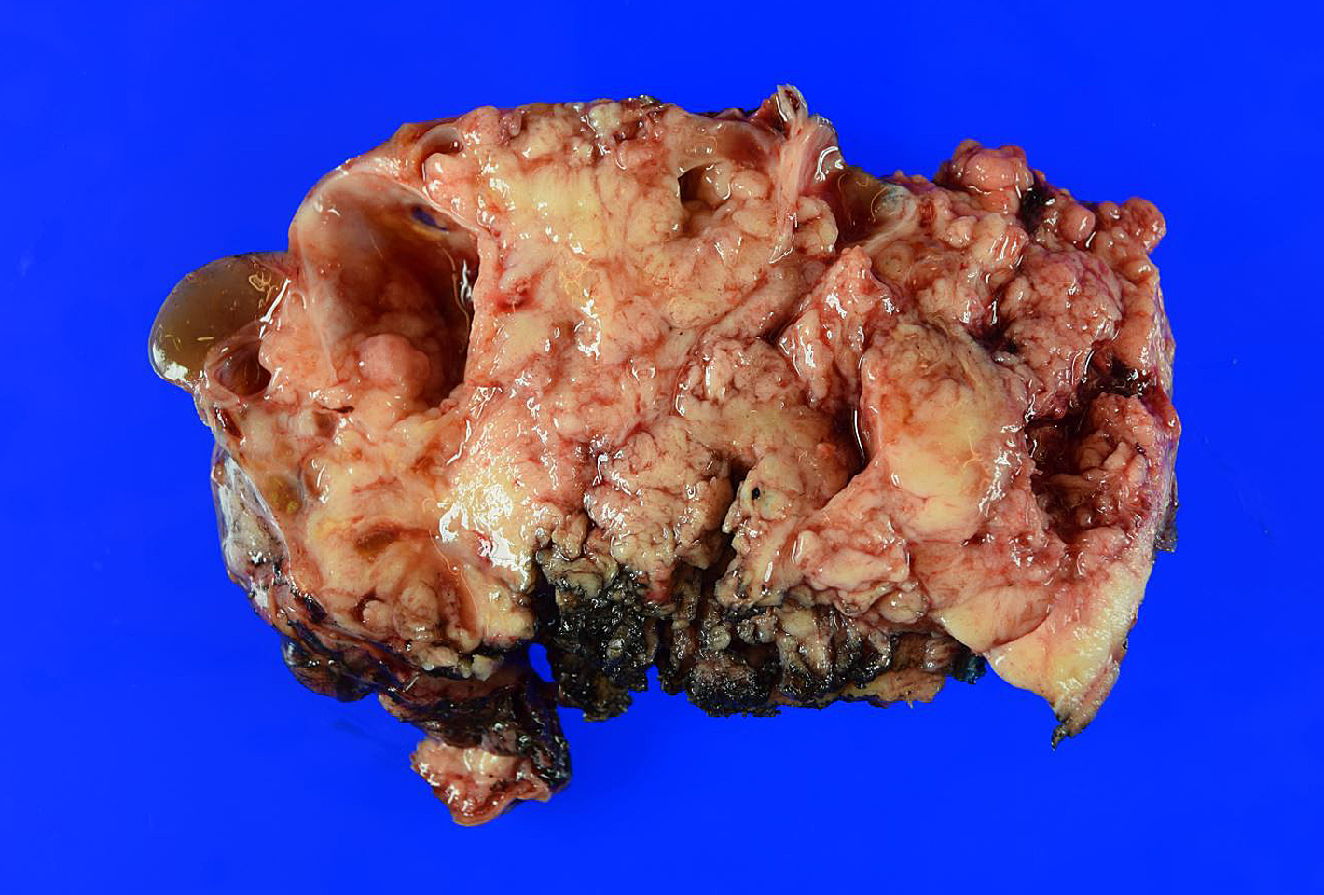
Clinical History
50 year old woman presented with a large ovarian mass
15 cm solid and cystic, hemorrhagic and necrotic

Slide 4
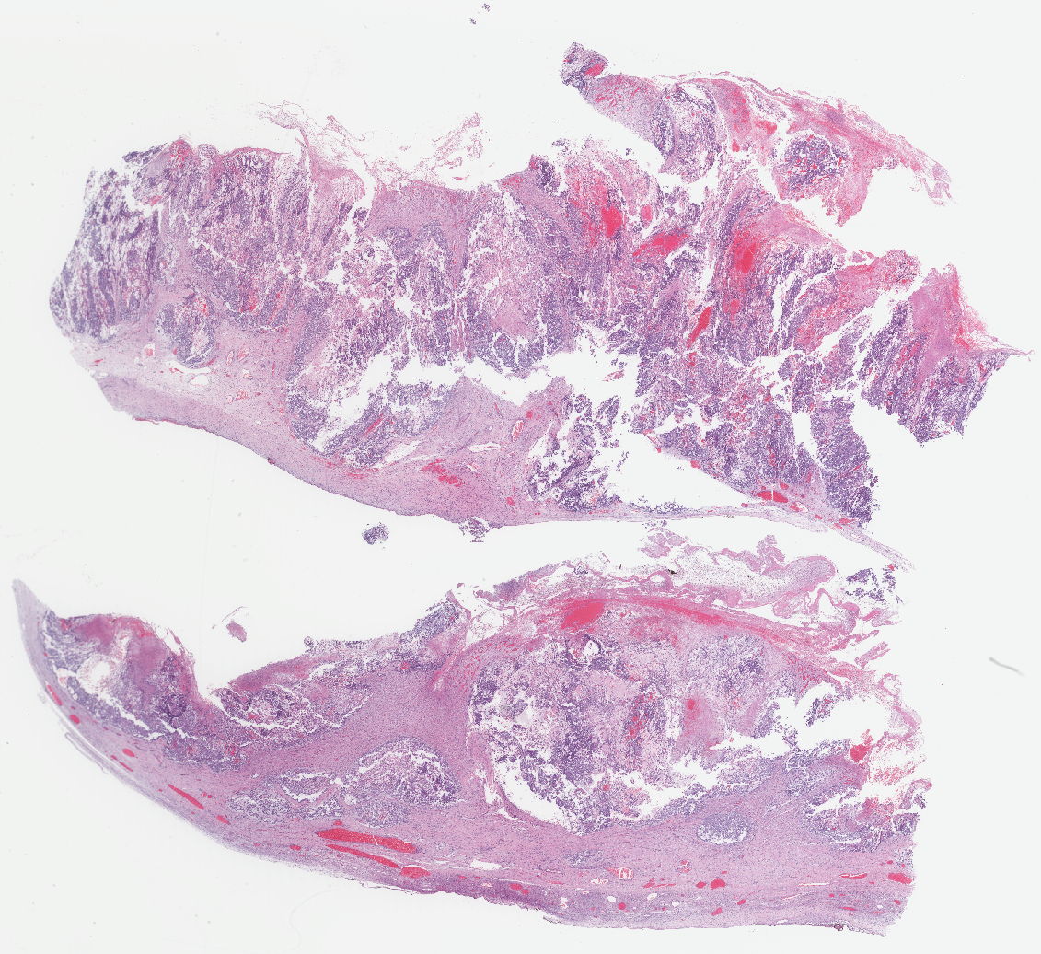

Slide 5
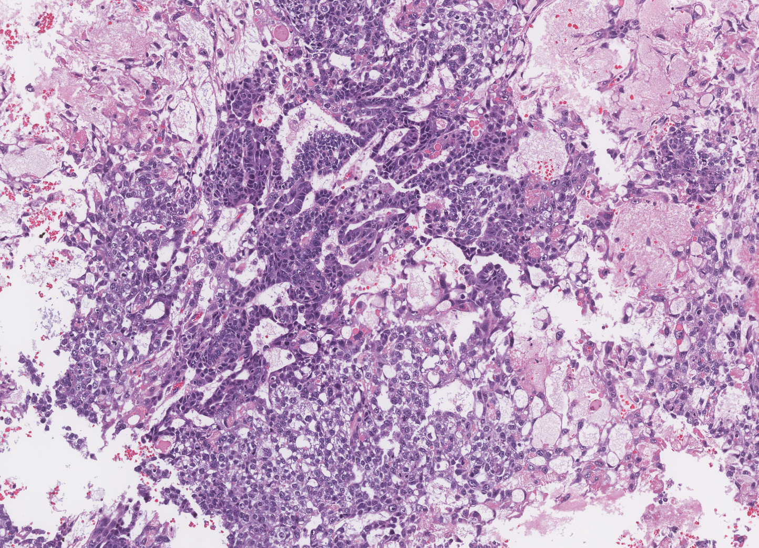
Multiple growth patterns

Slide 6
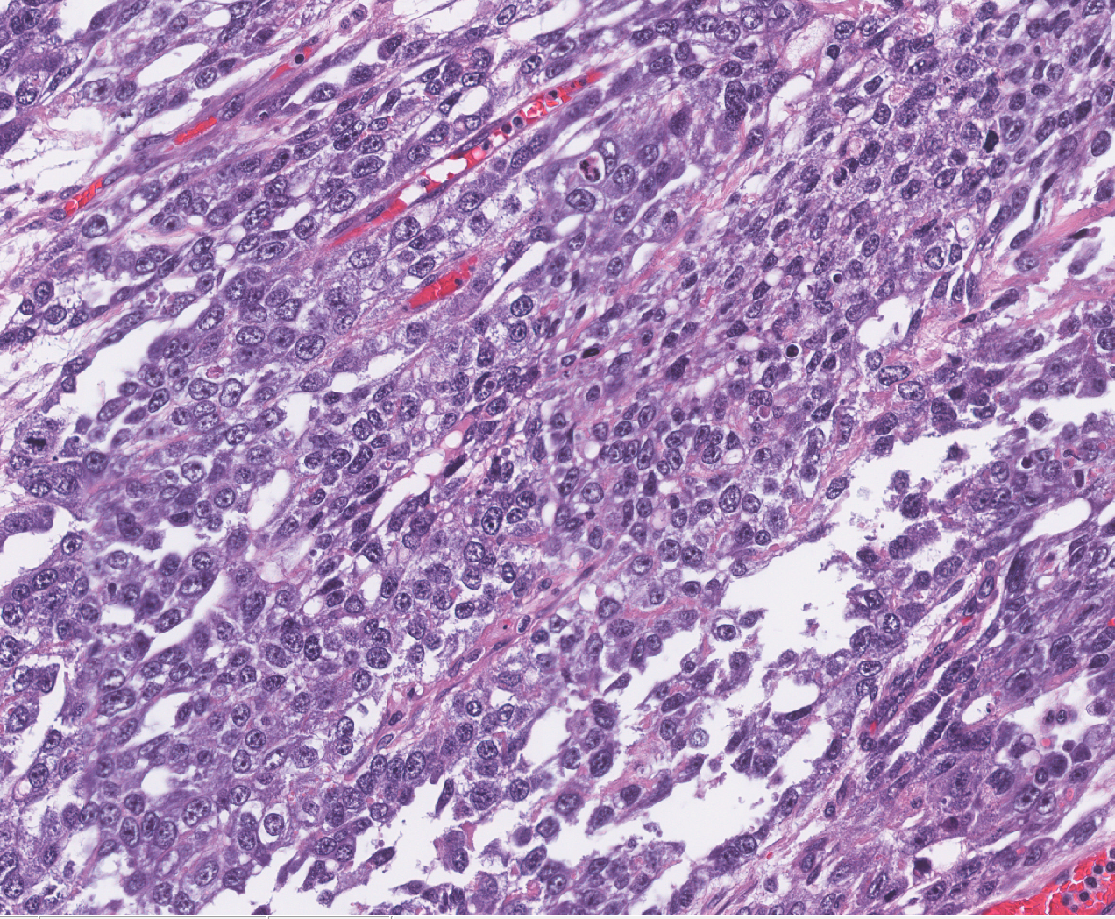
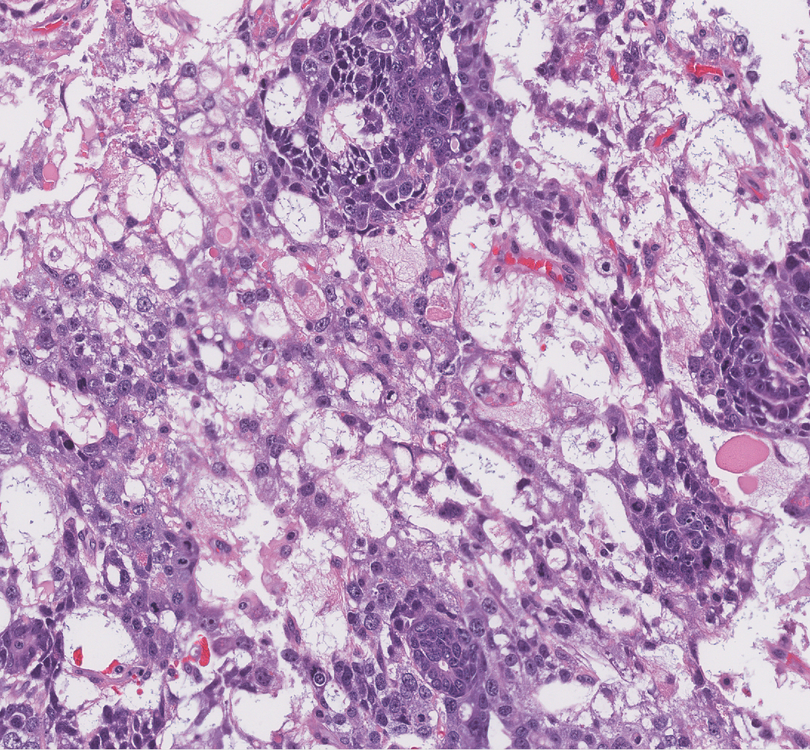
Solid
Microcysts

Slide 7
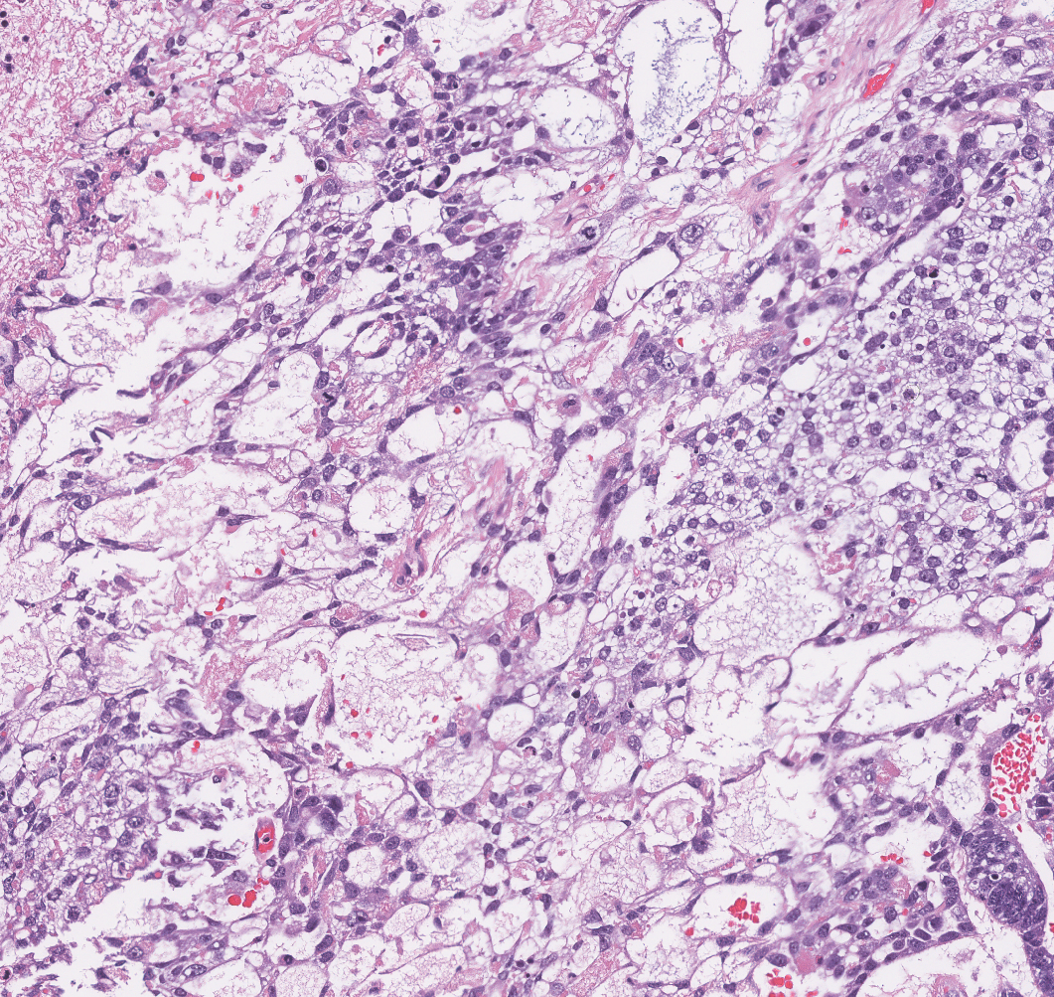
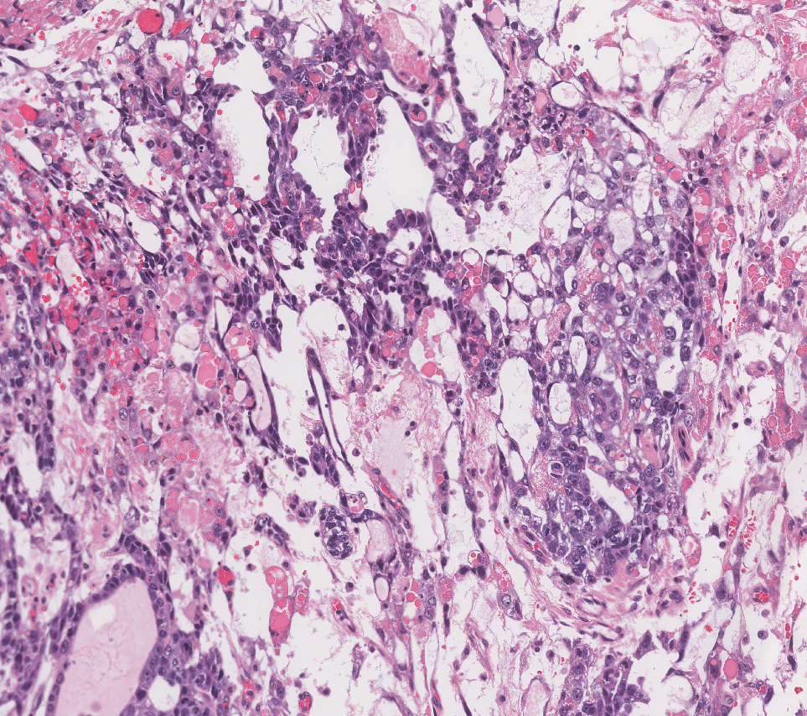
Microcystic / reticular
Tubule-like growth and microcysts

Slide 8
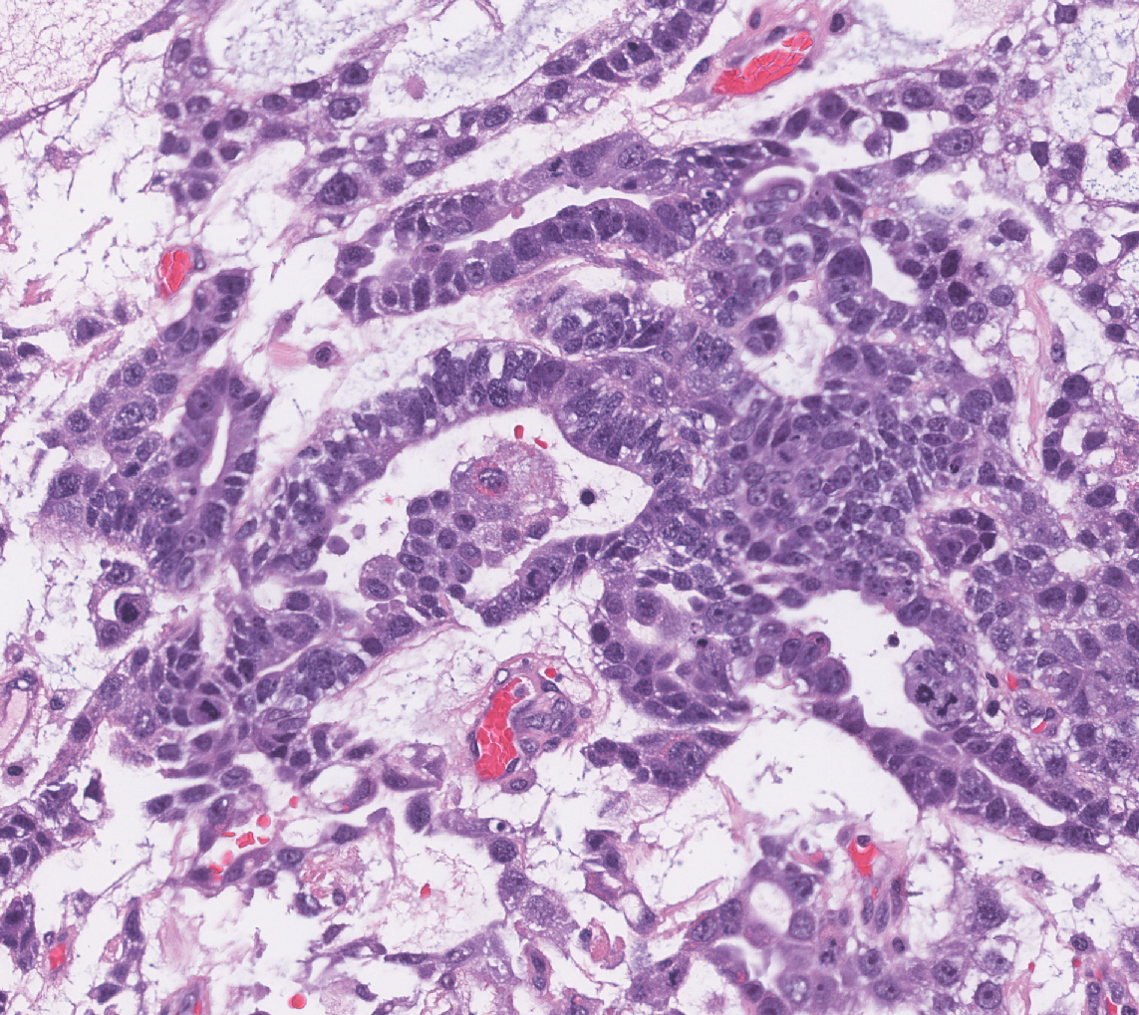
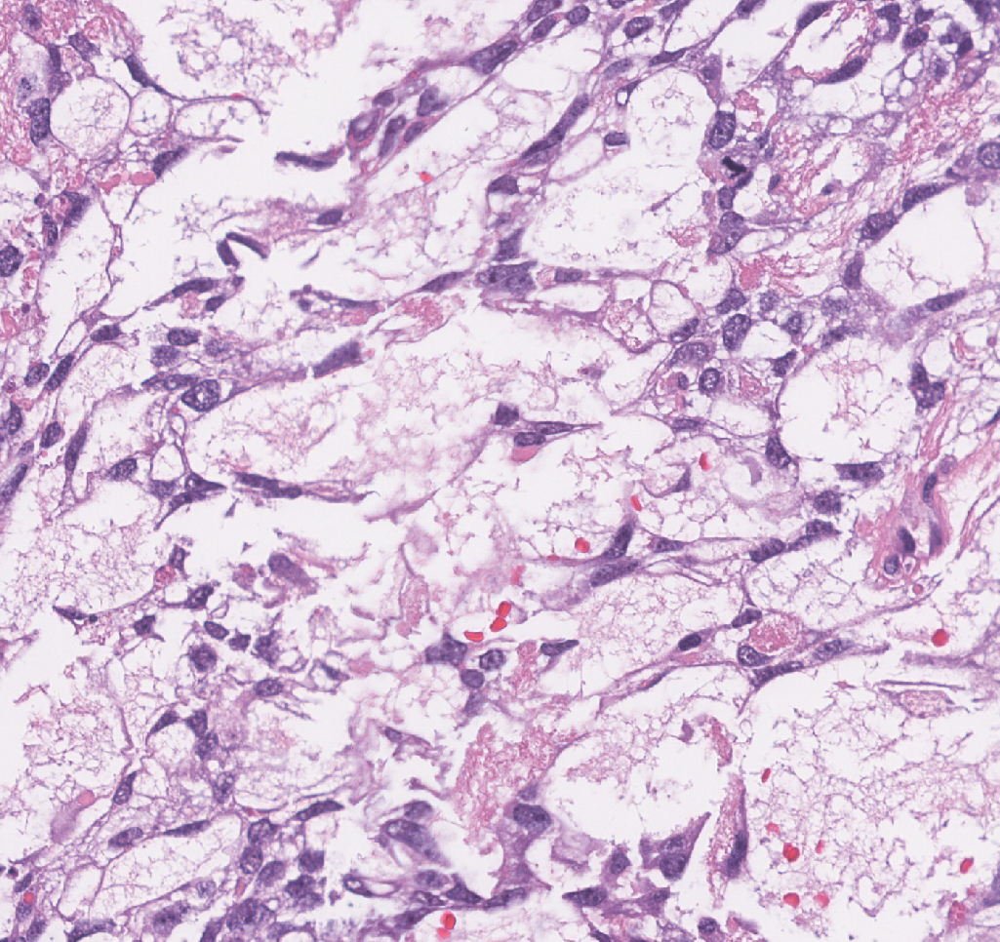
Gland-like
Minimal atypia, minimal mitoses

Slide 9
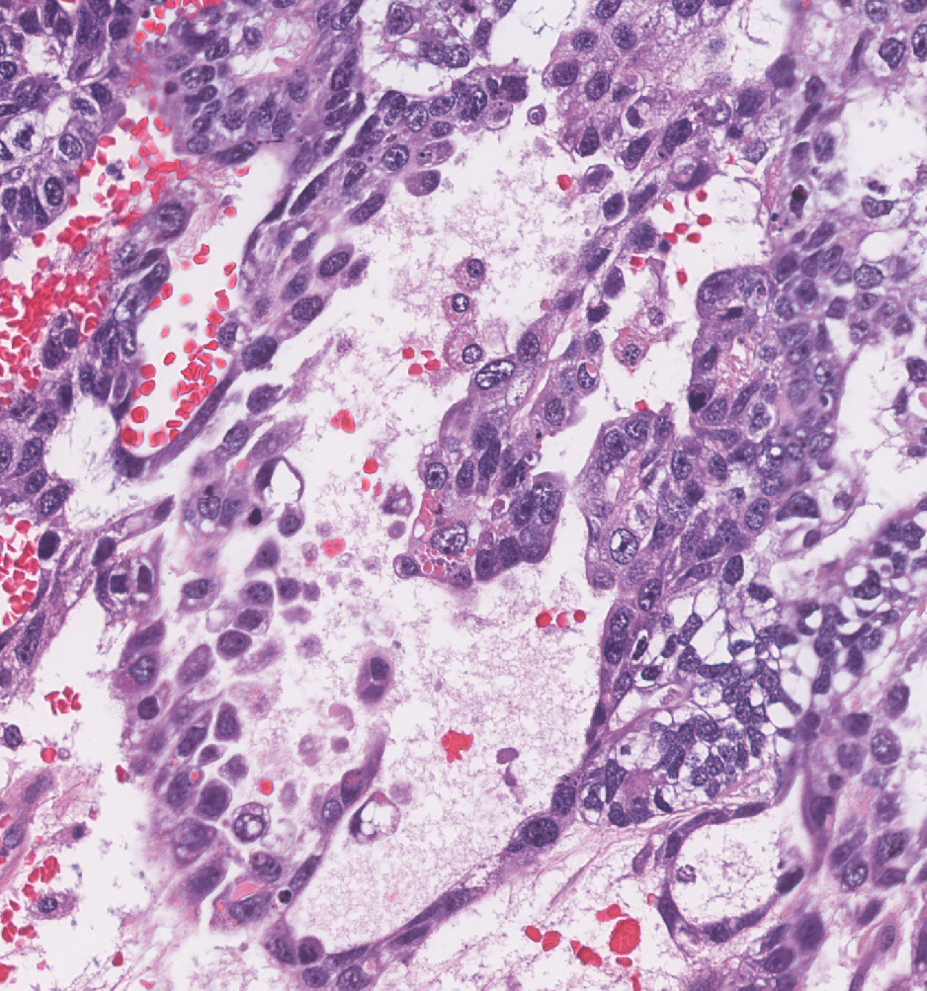
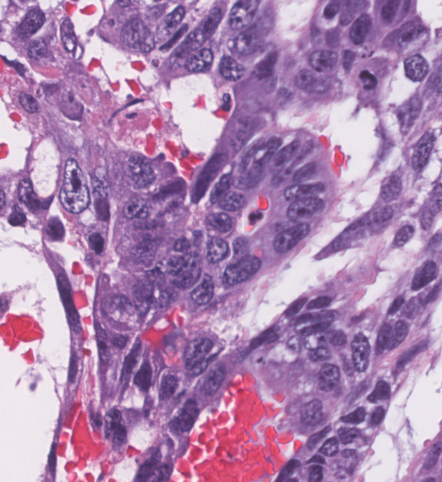
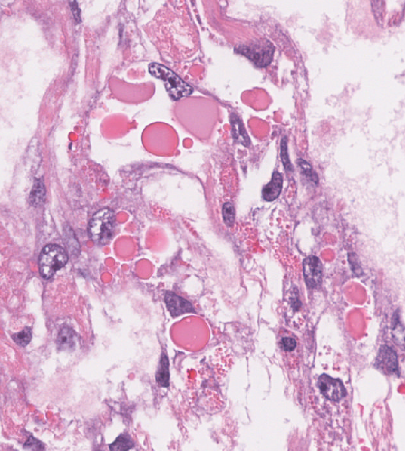
Papillae
Hyaline Globules

Slide 10
Your thoughts on the diagnosis ?

Slide 11
Differential Diagnosis
Tumor Family | Tumor Type | Initial Immunostain Strategy
Germ cell | Yolk sac tumor Malignant struma ovarii | SALL4
Epithelial | Clear cell carcinoma Endometrioid carcinoma Low grade serous carcinoma Metastatic cancer | EMA
Sex cord-stromal | Microcystic stromal tumor Adult granulosa cell tumor | FOXL2 (SF1, calretinin, inhibin)

Slide 12
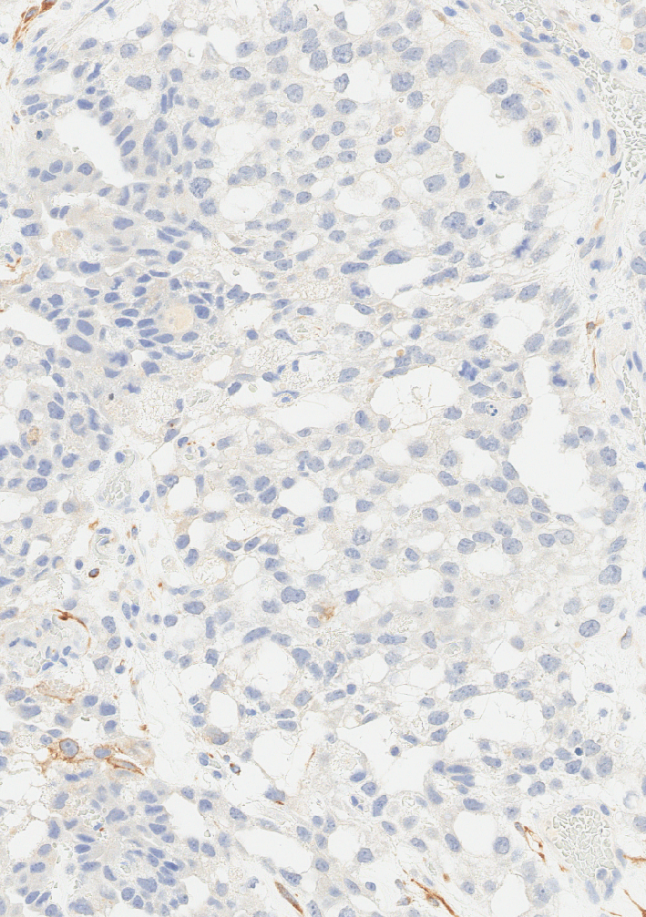
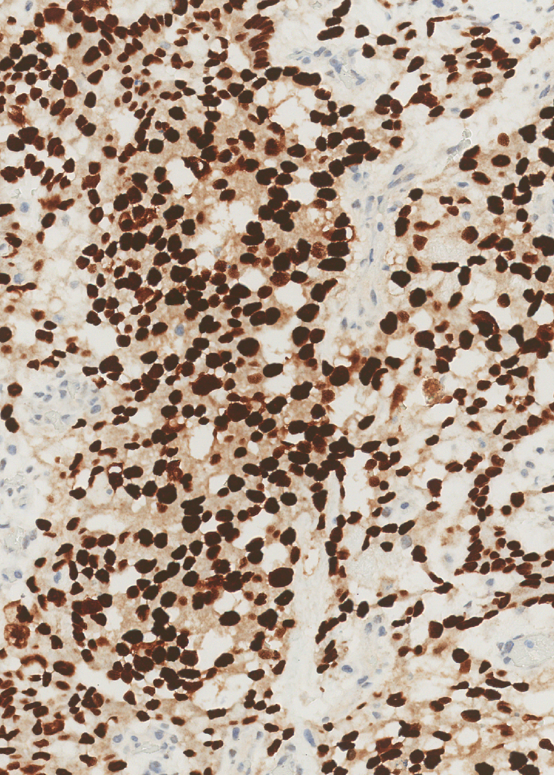
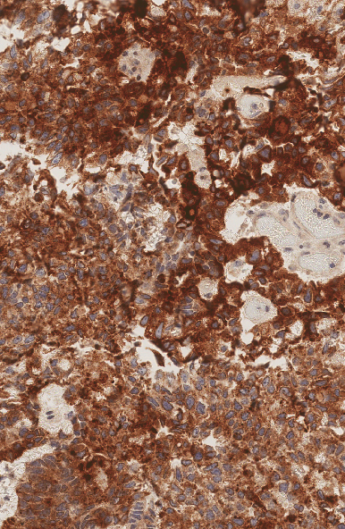
EMA
SALL4
Glypican-3

Slide 13
Diagnosis
Yolk Sac Tumor

Slide 14
Ovarian Yolk Sac Tumor
WHO Definition:
Primitive germ cell tumor with endodermal differentiation
Morphologic Pattern of Tumor | Developmental Differentiation | Corresponding Developmental Tissue
Reticular Solid Endodermal sinus | Extra embryonal endoderm | Primitive endoderm Secondary yolk sac
Polyvesicular |  | Allantois
Parietal |  | Murine parietal yolk sac
Glandular Hepatoid | Somatic endoderm | Primitive intestine Primitive lung Primitive liver

Slide 15
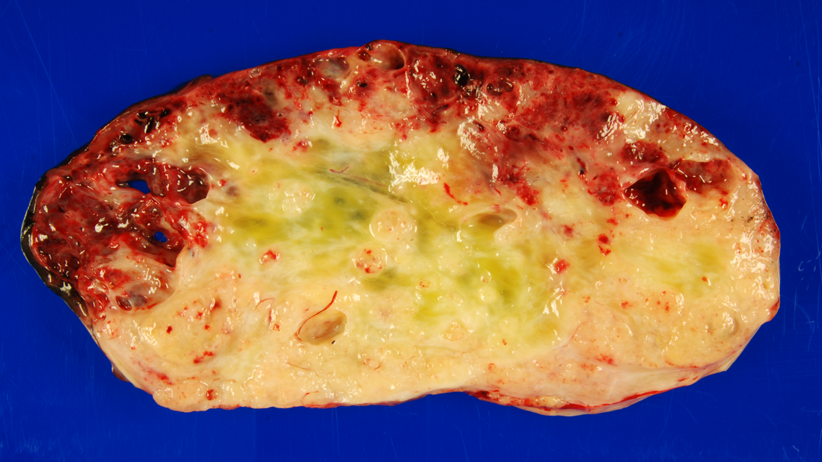
Ovarian Yolk Sac Tumor
Reproductive age
Elevated serum AFP
Majority have chromosome 12 abnormality (isochromosome 12p, detectable by FISH)
    not needed for diagnostic purposes
Unilateral
~15 cm
Solid/cystic, friable, hemorrhagic, necrotic
Clinical setting:
Pathogenesis:
Macroscopy:
Serum AFP in Ovarian Tumors
Yolk Sac Tumor
Sertoli Leydig cell tumor with hepatoid heterologous elements
Rarely: clear cell carcinoma

Slide 16
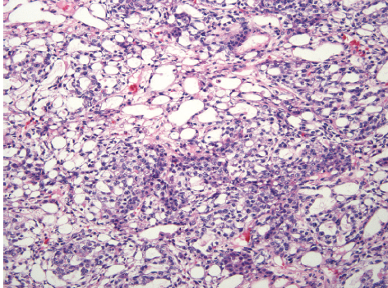
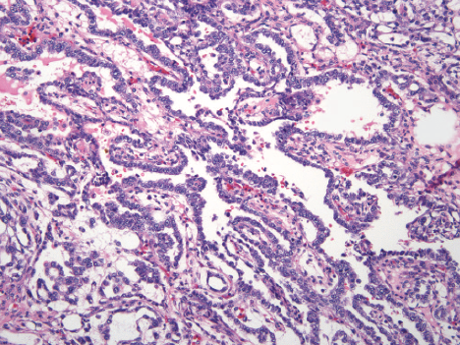
Ovarian Yolk Sac Tumor
Diverse array of morphology poses diagnostic pitfalls
Reticular Pattern
Endodermal Sinus Pattern
Major Differential Diagnosis
Clear cell carcinoma
Low / high grade serous carcinoma
Metastatic non-gyn carcinoma
Microcystic stromal tumor
Major Differential Diagnosis
Embryonal carcinoma
Low / high grade serous carcinoma
Retiform Sertoli Leydig Cell Tumor

Slide 17
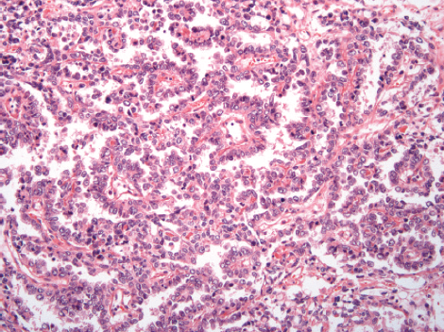
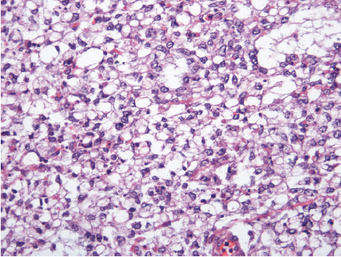
Ovarian Yolk Sac Tumor
Diverse array of morphology poses diagnostic pitfalls
Papillary Pattern
Schiller-Duval Bodies
Solid Pattern
Major Differential Diagnosis
Low / high grade serous carcinoma
Endometrioid carcinoma
Clear cell carcinoma
Major Differential Diagnosis
Clear cell carcinoma
Low / high grade serous carcinoma
Metastasis of non-gyn carcinoma

Slide 18
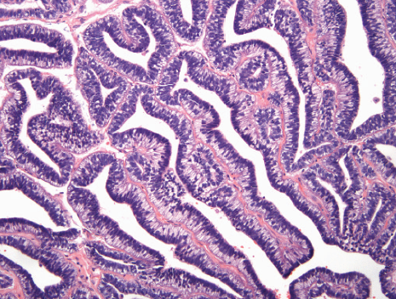
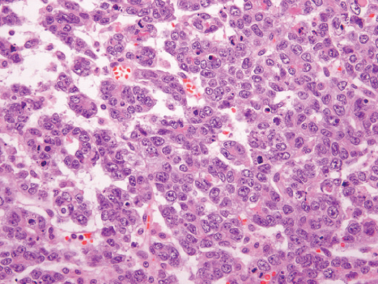
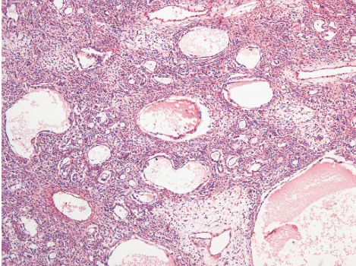
Ovarian Yolk Sac Tumor
Diverse array of morphology poses diagnostic pitfalls
Intestinal / Endometrioid Pattern
Hepatoid Pattern
Polyvesicular Pattern
Major Differential Diagnosis
Endometrioid carcinoma
Metastasis of non-gyn carcinoma
Major Differential Diagnosis
Endometrioid carcinoma
Steroid cell tumor
Metastasis of non-gyn carcinoma
Melanoma
Major Differential Diagnosis
Clear cell carcinoma
Metastasis of non-gyn carcinoma

Slide 19
Determining Ovarian Tumor Family
General Approach to Initial Immunohistochemistry
Epithelial
Tumors
Malignant Germ Cell
Tumors
Sex Cord-Stromal
Tumors
EMA
SALL4
FOXL2*
Calretinin
Inhibin
SF1
Negative
in YST
Positive
in YST
Negative
in YST
*except steroid cell tumors
PMID: 23240671

Slide 20
Determining Ovarian Tumor Family
General Approach to Initial Immunohistochemistry
Epithelial
Tumors
Malignant Germ Cell
Tumors
Sex Cord-Stromal
Tumors
EMA
SALL4
FOXL2*
Calretinin
Inhibin
SF1
Keratins
Caution advised using keratins to confirm “epithelial differentiation”
EMA is much more specific for this purpose
*except steroid cell tumors
PMID: 23240671

Slide 21
Subtyping Germ Cell Tumors
Immunohistochemistry
Malignant Germ Cell
Tumors
SALL4 positive
Glypican 3
AFP
+/- HNF1
+/- CDX2
OCT4
CD117
D240
SOX2
CD30
Yolk Sac Tumor
Dysgerminoma
Embryonal carcinoma
PMID: 23240671

Slide 22
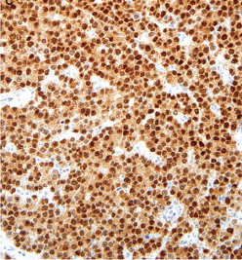
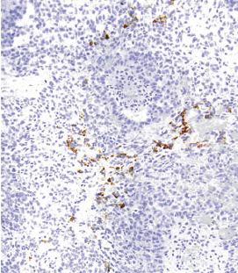
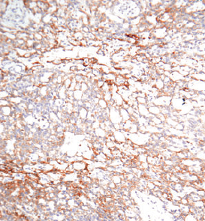
Ovarian Yolk Sac Tumor
SALL4
AFP
Glypican3
Nuclear stain pattern
Cytoplasmic stain pattern
Cytoplasmic stain pattern

Slide 23

Ovarian Yolk Sac Tumor
Tumor stage
Bleomycin, etoposide, cisplatin: 3 cycles
Prognostic Variables:
Treatment:
Stage | Incidence | 5 year Survival
I-II | 58% | >95%
III | 30% | 70%
IV | 12% | 50%
PMID 28803748, 29194189
www.nccn.org

Slide 24
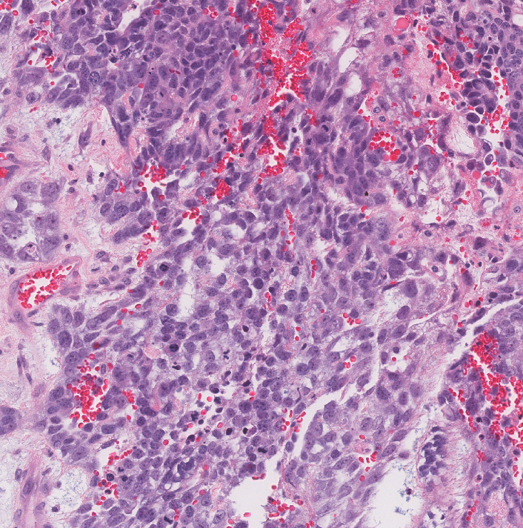
Ovarian Yolk Sac Tumor
History of its Discovery
First studied in early 1900’s, an era when “comparative morphology” drove tumor classification
New Tumor “X”
Pattern Matching
Developmental anatomy
Animal morphology
Other human tumors

Slide 25
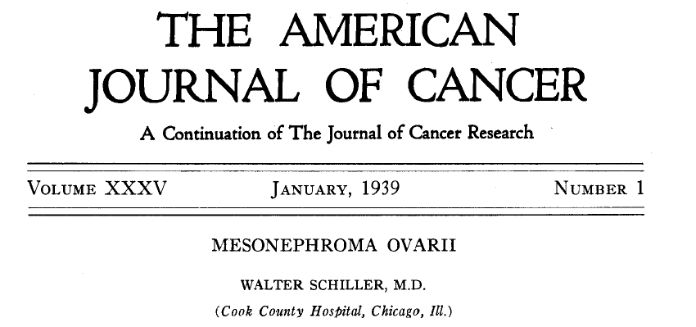
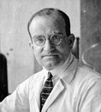
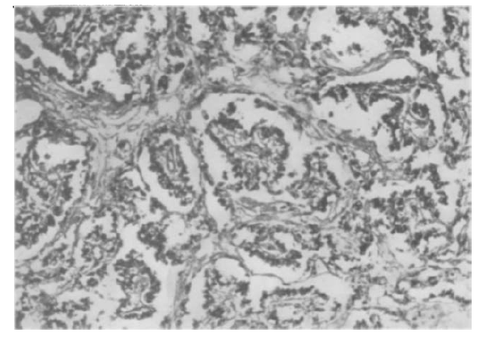
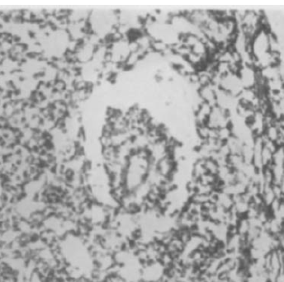
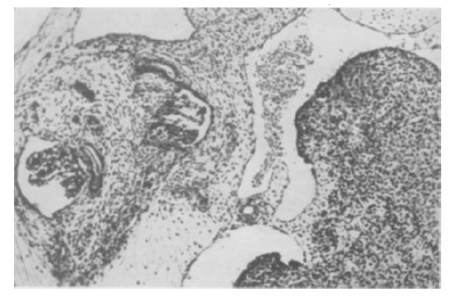
Walter Schiller
1887-1960
Mesonephroma (a.k.a “Yolk Sac Tumor”)
Embryo: Mesonephric system

Slide 26
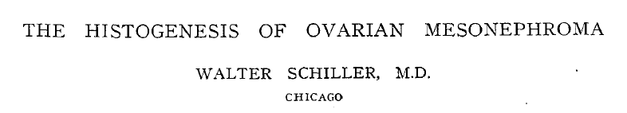
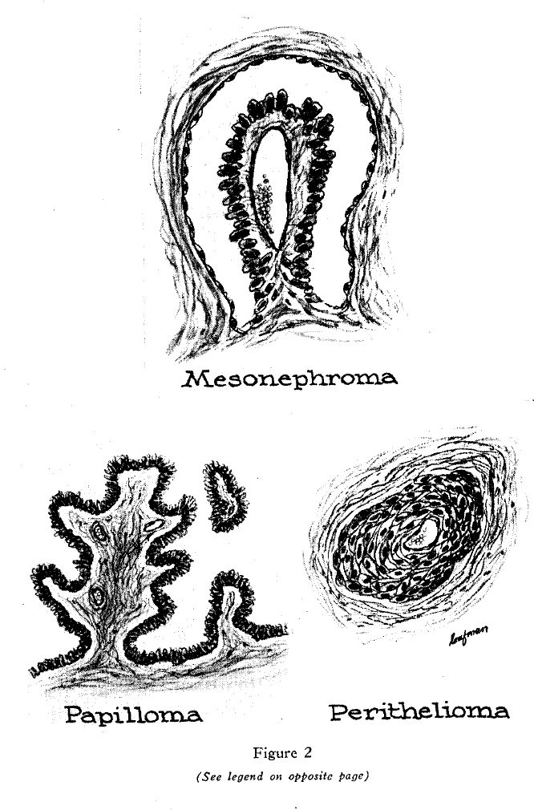
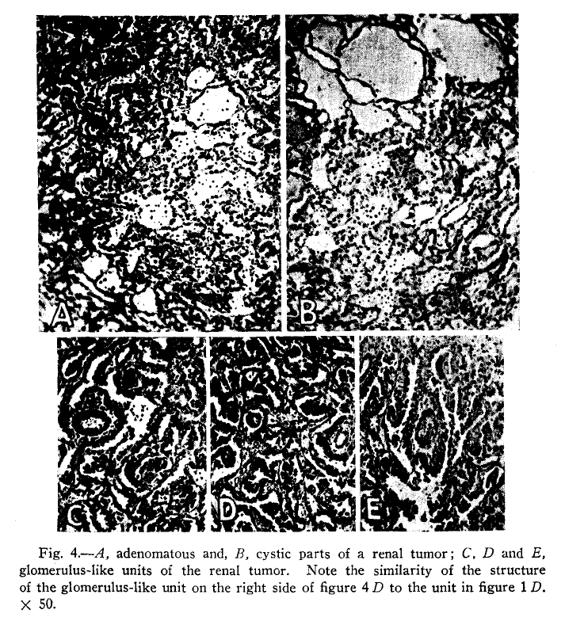
Walter Schiller
1887-1960
Mesonephroma (a.k.a “Yolk Sac Tumor”)
Renal Cell Carcinoma

Slide 27
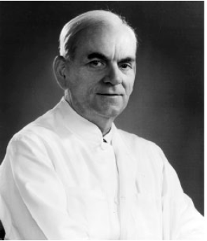
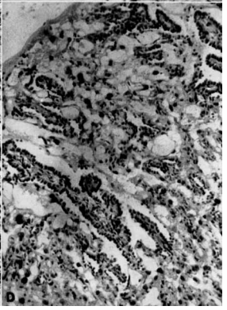
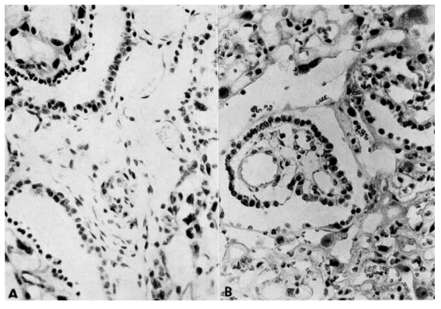
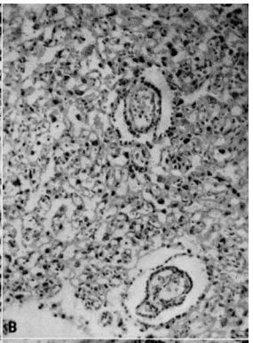
Gunnar Teilum
1902-1980
Tumor Patterns Resemble Rat Placenta
Endodermal Sinuses of Rat Placenta

Slide 28
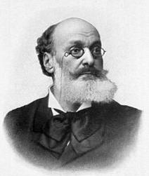
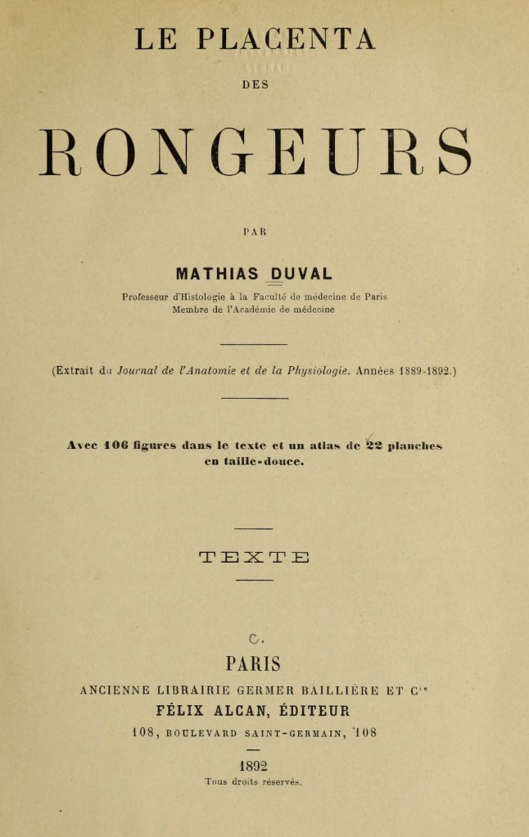
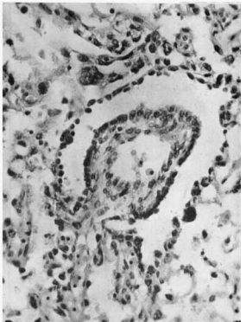
Mathias Duval 1844-1907
Placenta of the Rat
Placental Endodermal Sinus
Sinus
Endoderm of Yolk Sac

Slide 29
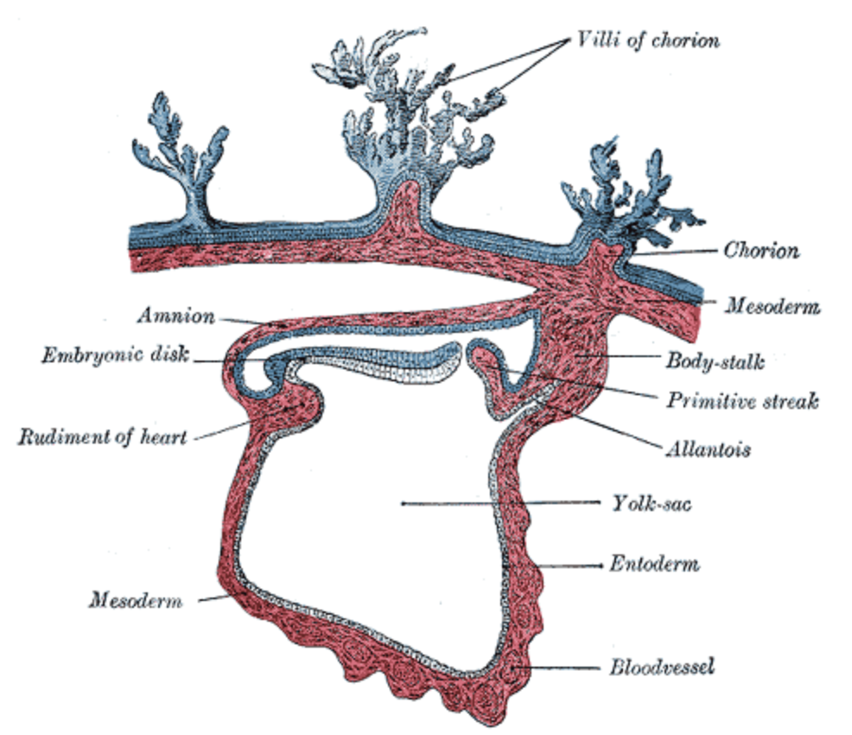
Gunnar Teilum
1902-1980
Tumor Patterns Resemble Various Yolk Sac/Allantoic-derived Tissues

Slide 30
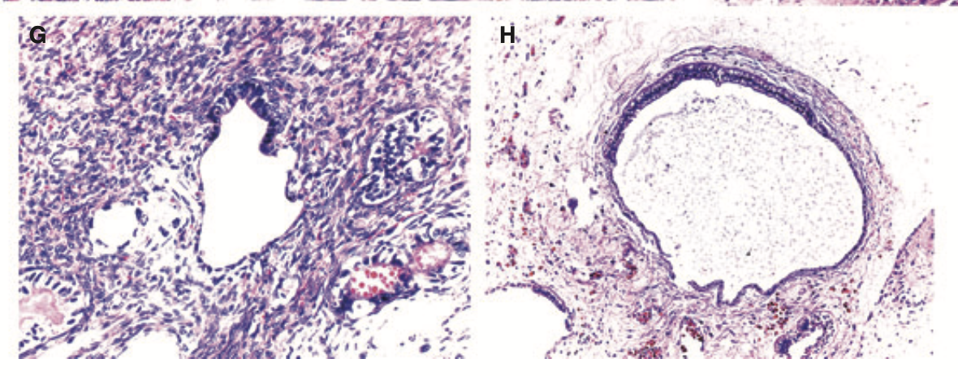
Gunnar Teilum
1902-1980
Polyvesicular pattern
Yolk Sac Tumor
Allantoic remnant
Normal development
Figures from PMID: 22008025

Slide 31
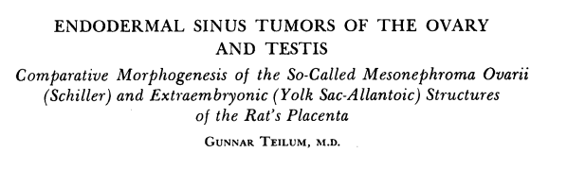
Gunnar Teilum
1902-1980
Cancer. 1959 PMID: 13837288

Slide 32
Major Advance in Understanding the Histogenesis of Yolk Sac Tumor
1930’s: Mesonephric origin (Schiller)
1950’s: Germ cell origin (Teilum)

Slide 33
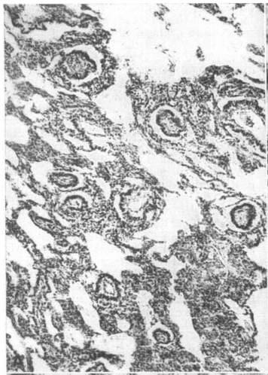
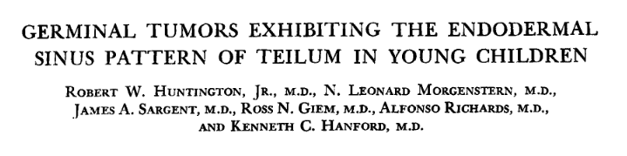
Introduction of the term “Schiller-Duval Body”
Schiller
Duval
Cancer 1963. PMID: 13955791

Slide 34
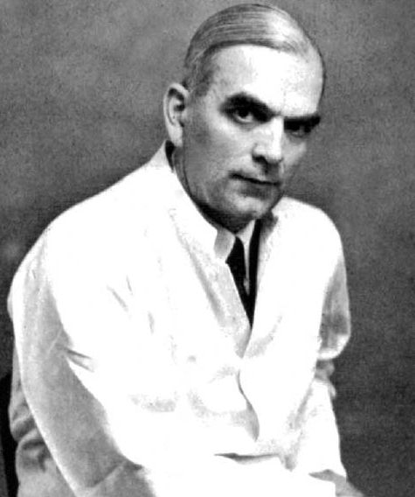
Should Yolk Sac Tumor Have Been Called Teilum Tumor ?
Gunnar Teilum
1902-1980

Slide 35
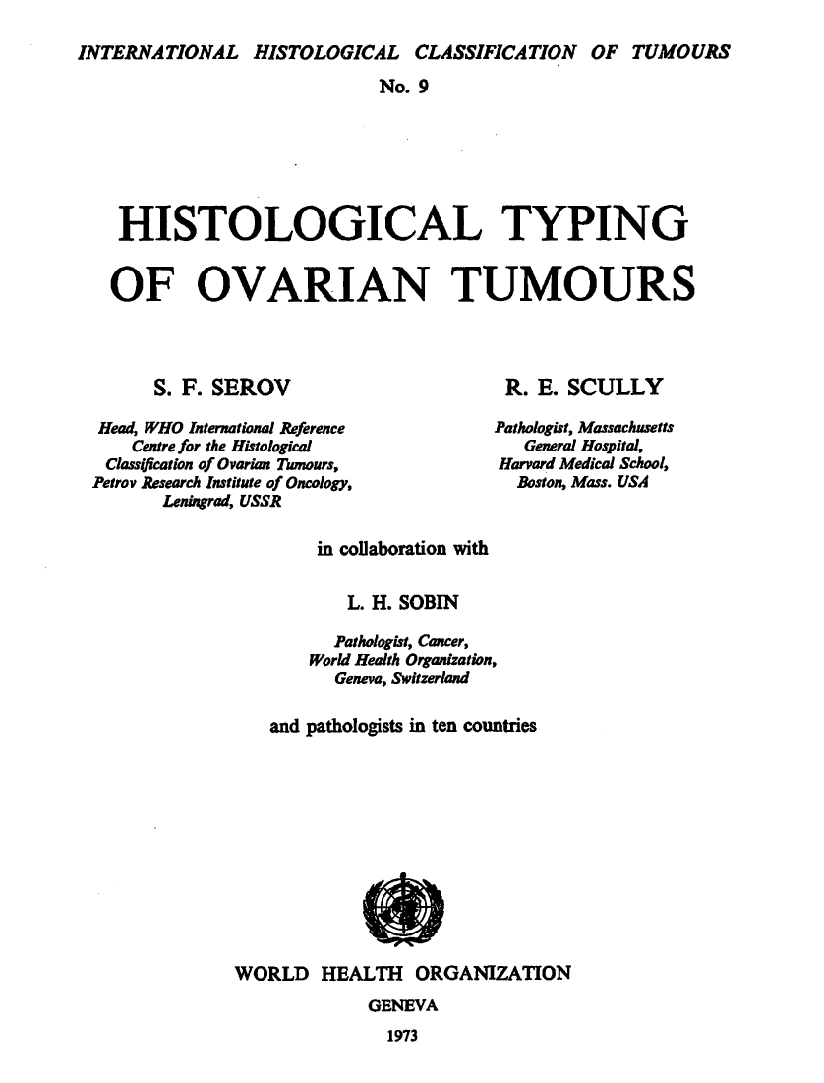
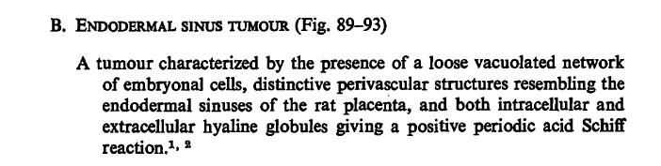



1st Edition
Gunnar Teilum

Slide 36
1st Edition
Gunnar Teilum
Humberto Torloni Antonio Luisi

Slide 37

Alpha FetoProtein (AFP) Staining Demonstrated in Yolk Sac Tumor
Further link to germ cell origin of tumor
PMID: 4136799

Slide 38


2nd Edition

Slide 39





5th Edition
Proposal to call these Primitive Endodermal Tumor

Slide 40
Case Presentation Diagnosis
Yolk Sac Tumor
Does this correlate with the clinical context ?
Clinical History
Macroscopic
Pathology
Microscopic
Pathology

Slide 41
Case Presentation Diagnosis
Yolk Sac Tumor
Does this correlate with the clinical context ?
A 50 year old woman presented with a large ovarian mass

Slide 42
Bimodal Age Distribution of Ovarian Yolk Sac Tumor
PMID: 22252431

Slide 43
Ovarian/Endometrial Yolk Sac Tumor Presenting Beyond Reproductive Age
Most are associated with ovarian/endometrial carcinoma or endometriosis
      Exhibit molecular alterations of the ovarian/endometrial carcinoma
Behavior:
      Adverse (compared to conventional yolk sac tumor)
      Require treatment based on the carcinoma
PMID 21804392 ; 8764742 ; 27334714 ; 29106744; 32558949; 32404953

Slide 44

More Tissue Examined to Search for Under-sampled Carcinoma

Slide 45


Additional Tissue Sampling
YST component

Slide 46

Additional Tissue Sampling
Glandular and squamous component

Slide 47


Endometrioid Carcinoma

Slide 48



Endometrioid Carcinoma
EMA
SALL4

Slide 49
Case Presentation Diagnosis
Yolk Sac Tumor
Revised Diagnosis
Endometrioid Carcinoma with Yolk Sac Tumor-like Features
a.k.a. “Somatically-derived Yolk Sac Tumor”

Slide 50
Somatically-derived Yolk Sac Tumor
WHO Definition:
Clinical setting:
Clinical significance:
YST-like features co-existing with carcinoma (any histotype) or endometriosis
Post-reproductive age
Mostly occurs in primary ovarian tumors, but may be primary endometrial tumor
Behavior is based on the carcinoma, not the YST component
Poor prognosis
Chemotherapy should be defined by the carcinoma, not just the YST component
PMID 21804392 ; 8764742 ; 27334714 ; 29106744; 32558949; 32404953

Slide 51
Somatically-derived Yolk Sac Tumor
YST component:
Carcinoma component:
Same morphology and immunophenotype as classical YST
Most histotypes have been reported; rare cases of endometriosis-only or YST-only
Growth Patterns
Glandular
Papillary
Reticular
Solid
Hepatoid
Likely explanation for so-called “hepatoid carcinoma”
Endometrioid carcinoma
Clear cell carcinoma
High grade serous carcinoma
Carcinosarcoma
Mucinous carcinoma
PMID 21804392 ; 8764742 ; 27334714 ; 29106744; 32558949; 32404953, 36314449

Slide 52
Somatically-derived Yolk Sac Tumor
Ratio of YST to carcinoma is highly variable
May be under 25% YST or more than 90% YST
May be associated only with endometriosis without any carcinoma
Rare cases may not have a carcinoma component
Extensive tissue sampling advised if patient is older
May represent either:
    “Overgrowth” of the YST component
    Under-sampled carcinoma
PMID 21804392 ; 8764742 ; 27334714 ; 29106744; 32558949; 32404953

Slide 53
Somatically-derived Yolk Sac Tumor
Immunohistochemistry is nearly the same as for classic tumor components
 | Marker | Carcinoma | YST
YST markers | SALL4, Glypican 3, AFP, HepPar1 | - | +
Mullerian marker | PAX8 | + | -
Epithelial markers | EMA, CK7 | + | +/-
 |  | Endometrioid carcinoma | YST
 | Estrogen receptor | + | -
 |  | Clear cell carcinoma | YST
 | NapsinA | + | -
 | HNF1 | + | +/-
PMID: 29106744

Slide 54
Somatically-derived Yolk Sac Tumor
Molecular Diagnostic Testing is Interesting but Not Necessary for Diagnosis
Isochromosome 12p (FISH test)
Tumor sequencing: shows clonality between carcinoma and YST
 | iso 12p
Classic YST | Present
Somatically-derived YST | Absent
Endometrioid carcinoma
YST
Both components exhibit the same “endometrioid” type gene alterations
Clear cell carcinoma
YST
Both components exhibit the same “clear cell” type gene alterations
High grade serous cancer
YST
Both components exhibit the same “HGSC” type gene alterations
PMID: 32558949; 32404953

Slide 55
Stage and Age are Main Prognostic Variables for Ovarian YST
Stage
Age
Somatically-
derived YST
PMID: 28803748

Slide 56
Bimodal Age Distribution of Ovarian Yolk Sac Tumor
PMID: 22252431

Slide 57
Bimodal Age Distribution of Ovarian Yolk Sac Tumor
True Germ Cell Tumor
Somatically Derived Germ Cell Tumor
PMID: 22252431

Slide 58


Earliest Report of Concurrent YST and Endometrioid Cancer
50 y woman
1987. PMID: 3679203

Slide 59

Term “Somatically Derived Yolk Sac Tumor Introduced in 2016
18 cases
All age >40
Mostly glandular pattern YST
7/10 died within 27 months (all high stage tumors)

Slide 60


Yolk Sac Tumor Features are NOT Pathognomonic of Primary Origin in Ovary
Yolk sac tumor
features
Yolk sac tumor
features
Ovarian
metastasis of
gastric cancer
Ovarian
metastasis of
gastric cancer
admixed with
yolk sac tumor
features
Images from PMID: 18317220

Slide 61
Yolk Sac Tumor Morphology in Non-Gynecological Cancers
Primary Site | PMID
Gastric carcinoma | 21355958, 29270580, 37900463, 33956241, 29207718
Urothelial carcinoma | 32493368, 34255554
Sino-nasal carcinoma | 31468350, 29166820, 33824593, 34420180, 36514645, 35257325

Slide 62



Vulvar Yolk Sac Tumor: A Re-evaluation
Somatic-derived INI-1 deficient tumors, not germ cell tumors
INI-1
SALL4
Glypican
AFP
PMID: 34265804, 35758187, 37876879

Slide 63



Sino-nasal Yolk Sac Tumor: A Re-evaluation
Somatic-derived INI-1 deficient tumors, not germ cell tumors
INI-1
PMID: 31468350, 29166820, 33824593, 34420180, 36514645, 35257325

Slide 64

Choriocarcinoma Morphology In Female Genital Organs
Gestational Choriocarcinoma
endometrium
Germ Cell Choriocarcinoma
ovary
Somatically-Derived Choriocarcinoma
endometrium / ovary
PMID 19809555 ; 25105109 ; 28877059 ; 31421690

Slide 65
Theories on Tumorigenesis of Germ Cell Features in Carcinoma
An evolving field
Term | PMID
Neometaplasia | 3679203, 2878534
Retrodifferentiation | 4040885, 14436952
Transdifferentiation | 38391963, 36759286

Slide 66


Transdifferentiation: Driven by Complex Molecular Alterations
PMID 38391963

Slide 67


Transdifferentiation: Driven by Complex Molecular Alterations
Figure from PMID: 35639393

Slide 68

Transdifferentiation: Driven by Complex Molecular Alterations
Endometriosis
Left ovary
Presumed
Endometriosis
Colon serosa
Endometrial
Endometrioid
Carcinoma
Adapted from figure from PMID: 35639393

Slide 69
Evolution in Tumor Classification
20th Century
Comparative Morphology
21st Century
Comparative Genomics

Slide 70
Yolk Sac Tumor Morphology
In Female Genital Organs
Ovary
Endometrium
Vulva
Germ Cell Tumor
Transdifferentiated Carcinoma

Slide 71
Clinical Need to Distinguish Ovarian Carcinoma versus Yolk Sac Tumor
Why does this matter ?
Management | Carcinoma with Yolk Sac Tumor Features | Germ Cell Yolk Sac Tumor
Chemotherapy | Taxol, Carboplatin | Bleomycin, Etoposide, Cisplatin
Test for PARP inhibitor eligibility | Yes (HGSC) | No
Hereditary risk assessment | Yes (BRCA/Lynch syndrome) | No
2024 NCCN Guidelines: www.nccn.org

Slide 72
Practical Approach to Classification of Ovarian Yolk Sac Tumor
Classic Morphology and Immunophenotype
Reproductive Age?
Yes
No
Consistent
with
a Germ Cell Tumor
Submit more tissue to exclude Carcinoma / Endometriosis

Slide 73

Muito Obrigado !

